Slide 1
OPTOGENETICS
Discerning Brain Function with Light
Lesson 3

Slide 2
LESSON 3

Slide 3
Introduction - Optogenetics
Review the technologies used to discern brain function in the last class and the scale at which brain is studied for each.
Introduction to Optogenetics: Video
Goal: Build your own optogenetics vector.
Notes:
https://www.youtube.com/watch?v=D_9rdj4SJrc (SciShow5 minutes)
https://www.youtube.com/watch?v=I64X7vHSHOE (Nature video 4m26s)
https://www.youtube.com/watch?v=-8bMMuvpbkg (Neuro Transmissions 4m41s)
Advanced https://www.youtube.com/watch?v=dJ5MQluKcZY (MaxPlank Society 10m12s)

Slide 4
Review: Genetic Engineering Vectors
In your student groups: Review essential components of plasmid vectors by completing Lesson 3 Part 1 of the student handout.
Stop at the stop sign.

Slide 5
Optogenetics Offer Specificity at a Cellular Level
Image source: https://www.scientifica.uk.com/learning-zone/optogenetics-shedding-light-on-the-brains-secrets

Slide 6
Optogenetics Toolbox
Source: Mahmoudi, P., Veladi, H., & Pakdel, F. G. (2017). Optogenetics, Tools and Applications in Neurobiology. Journal of medical signals and sensors, 7(2), 71–79.

Slide 7
Optogenetics Toolbox Schematic
Source: Mukerjee, S., & Lazartigues, E. (2019). Next-Generation Tools to Study Autonomic Regulation In Vivo. Neuroscience bulletin, 35(1), 113–123. https://doi.org/10.1007/s12264-018-0319-2
Notes:
Optogenetics. The excitatory light-gated channel, channelrhodopsin, opens upon excitation with 475-nm light. This allows an influx of sodium ions that depolarizes the neuron. Halorhodopsin and archaerhodopsin silence the neuron by enabling hyperpolarization when they open in response to 575–600-nm light. Upon light activation, halorhodopsin allows chloride influx and archaerhodopsin pumps protons out of the cell, hyperpolarizing the neuron to silence it.

Slide 8
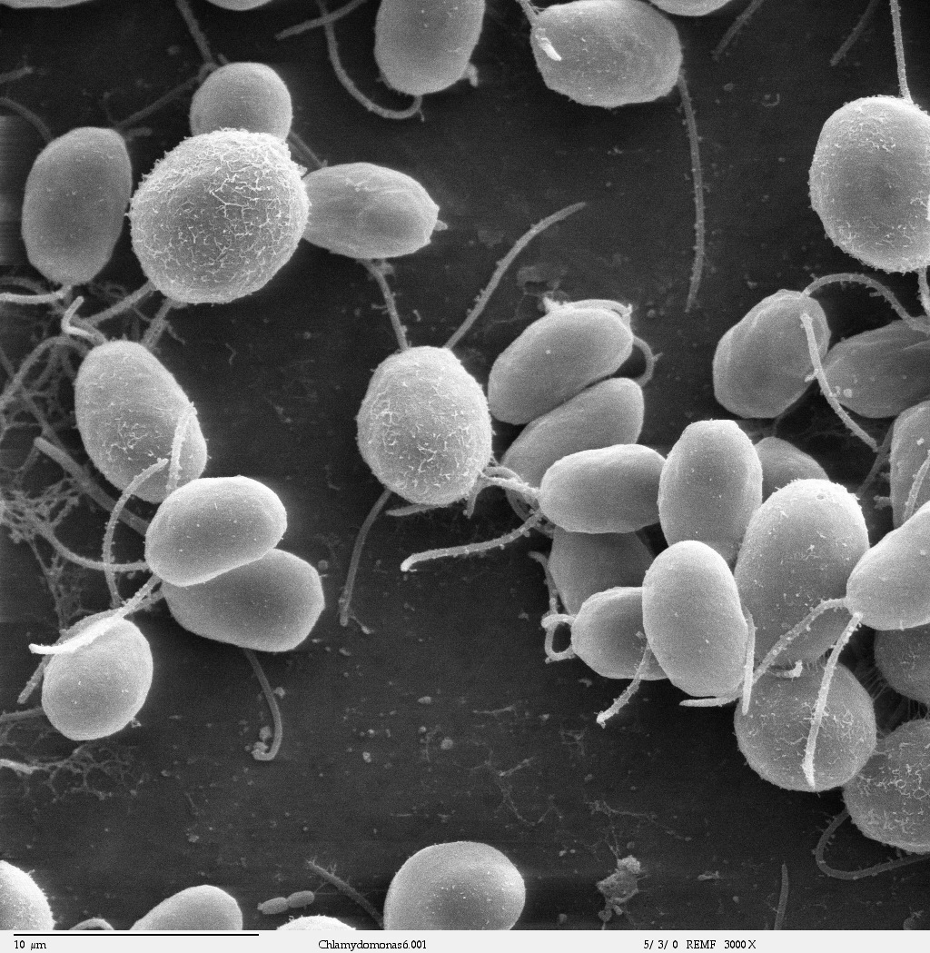
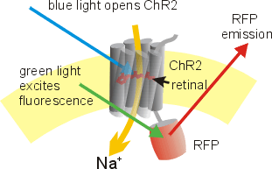
A Closer Look at the Opsins: Channelrhodopsin
Blue green algae Chlamydomonas reinhardtii
Genetically engineered channelrhodopsin tagged with RFP (red fluorescent protein) at the cytoplasmic C-terminal.
Source: By Millencolin - Own work, CC BY-SA 3.0, https://commons.wikimedia.org/w/index.php?curid=4570860
Chlamydomonas reinhardtii: Channelrhodopsin
Source: By A2-33 - Own work, CC BY-SA 3.0, https://commons.wikimedia.org/w/index.php?curid=18392488 and By Dartmouth Electron Microscope Facility, Dartmouth College - Source and public domain notice at http://remf.dartmouth.edu/imagesindex.html, Public Domain, https://commons.wikimedia.org/w/index.php?curid=2787116

Slide 9
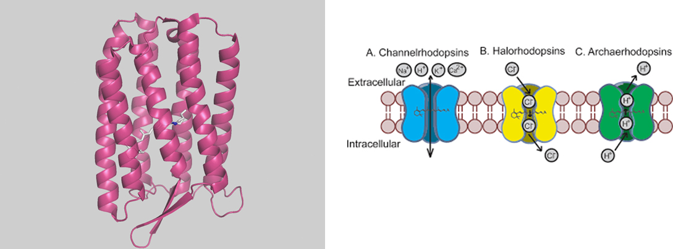
A Closer Look at Opsins: Archaerhodopsin-3
Archaerhodopsin: an outwards proton pump
Source: Han X. (2012). In vivo application of optogenetics for neural circuit analysis. ACS chemical neuroscience, 3(8), 577–584. https://doi.org/10.1021/cn300065j
Halorubrum sodomense Archaerhodopsin-3
Source: By ArchaerhodopsinGuy - Own work, CC0, https://commons.wikimedia.org/w/index.php?curid=101358124

Slide 10
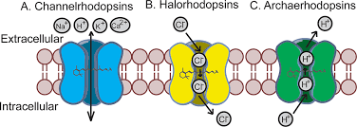
A Closer Look at Opsins: Halorhodopsin
Halorhodopsin: an inwards chloride pump
Source: Han X. (2012). In vivo application of optogenetics for neural circuit analysis. ACS chemical neuroscience, 3(8), 577–584. https://doi.org/10.1021/cn300065j
Natronomonas pharaonic halorhodopsin
Source: https://www.rcsb.org/structure/3a7k

Slide 11
Activity: Vector Design and Evaluation
In your student groups design your own optogenetic vector - see Student handout Lesson 3 Part 2
Write a brief overview of your designed vector.
Stop when done and get your work checked by your teacher.
In your student groups start Part 3 of the Lesson 3 student handout
Go to the Addgene Optogenetics website, select your opsins and draw a simplified version of any of the construct maps from the results.
Compare your designed construct with the ready to use construct and briefly write about how you can improve your designed constructs.
Submit your work.

Slide 12
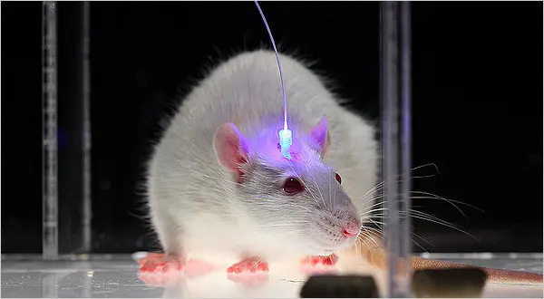
Doing the Actual Experiment!
We designed the construct.
Are there any other experimental parameters needed to conduct an optogenetics experiment?
Read: Researchers use flexible fiber probes to record, stimulate neural activity
Source: https://www.nytimes.com/2011/05/17/science/17optics.html

