Slide 1
OPTOGENETICS
Discerning Brain Function with Light

Slide 2
LESSON 1

Slide 3
Living with CIPA –
an autosomal genetic disorder
Young Girl Cannot Feel Pain, Battles Rare Medical Condition CIPA
Good Morning America | ABC News
https://www.youtube.com/watch?v=n6iOUW523BE 4m12s

Slide 4
Essential Questions:
How do we react to different sensory information around us?
Example: taking your fingers back after touching a hot pan or your reaction on smelling a malodorous scent.
With your partner draw a pathway or model showing the path of transmission of information in a normal person from a pain source and the subsequent reaction to it.
Optional to teacher led discussion: Students read https://www.brainfacts.org/thinking-sensing-and-behaving/touch/2012/touch-and-pain

Slide 5
Generalized structure of a neuron
Source: By Quasar Jarosz at English Wikipedia, CC BY-SA 3.0, https://commons.wikimedia.org/w/index.php?curid=7616130
Notes:
Labels: Dendrite, Nucleus, Soma, Axon, Myelin sheath, Schwann cell, Node of Ranvier, Axon terminal

Slide 6
Saltatory Conduction
Action potential propagation in myelinated neurons is faster than in unmyelinated neurons because of saltatory conduction.
By Dr. Jana - http://docjana.com/saltatory-conduction/ ; https://www.patreon.com/posts/4374048, CC BY 4.0, https://commons.wikimedia.org/w/index.php?curid=46818964

Slide 7
Action potential
By Helixitta - Own work, CC BY-SA 4.0, https://commons.wikimedia.org/w/index.php?curid=50019595

Slide 8
Action Potential
With your partner hypothesize what is happening in the neuronal cell?
By Laurentaylorj - Own work, CC BY-SA 3.0, https://commons.wikimedia.org/w/index.php?curid=26311114
Notes:
As an action potential (nerve impulse) travels down an axon there is a change in polarity across the membrane of the axon. In response to a signal from another neuron, sodium- (Na⁺) and potassium- (K⁺) gated ion channels open and close as the membrane reaches its threshold potential. Na⁺ channels open at the beginning of the action potential, and Na⁺ moves into the axon, causing depolarization. Repolarization occurs when the K⁺ channels open and K⁺ moves out of the axon, creating a change in polarity between the outside of the cell and the inside. The impulse travels down the axon in one direction only, to the axon terminal where it signals other neurons.

Slide 9
Typical neuronal action potential
By Original by en:User:Chris 73, updated by en:User:Diberri, converted to SVG by tiZom - Own work, CC BY-SA 3.0, https://commons.wikimedia.org/w/index.php?curid=2241513
Notes:
Approximate plot of a typical action potential shows its various phases as the action potential passes a point on a cell membrane. The membrane potential starts out at approximately −70 mV at time zero. A stimulus is applied at time = 1 ms, which raises the membrane potential above −55 mV (the threshold potential). After the stimulus is applied, the membrane potential rapidly rises to a peak potential of +40 mV at time = 2 ms. Just as quickly, the potential then drops and overshoots to −90 mV at time = 3 ms, and finally the resting potential of −70 mV is reestablished at time = 5 ms.

Slide 10
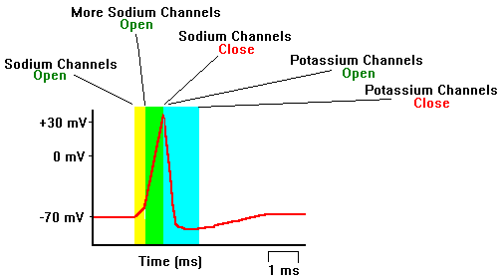
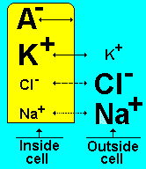
Molecular events during an action potential
https://faculty.washington.edu/chudler/ap.html
Notes:
For details refer to https://faculty.washington.edu/chudler/ap.html or any standard textbook.

Slide 11
How do neurons communicate?
Molecular Mechanism of Synaptic Function: https://www.biointeractive.org/classroom-resources/molecular-mechanism-synaptic-function 1m09s

