Slide 1
Neural Engineering
Neuroprosthetics is Problem

Slide 2
Posters should be up in room. Title at top, range ½ way down from Highly Agree to Highly Disagree
Humans only use 10% of their brain
Brain damage is always permanent
Humans have the largest brain of all animals
You are either Left-Brained (“artsy”) or Right-Brained (“logical”)
You lose large numbers of brain cells as you age

Slide 3
Posters should be up in room. Title at top, range ½ from Highly Agree to Highly Disagree
Humans only use 10% of their brain: False. We use 100% of our brains! Just think, if we only used 10% of our brain, then injury to 90% of the brain would be no big deal. All parts of the brain are always functioning at some level…unless they have suffered damage. Unfortunately this myth continues to be featured in popular media.
Brain damage is always permanent: False. It is true that the brain has a difficult time repairing/healing from serious injury, but there are many different types of brain damage; it depends on where the injury occurred and how serious it is. The brain can heal from mild injuries, such as a minor concussion, but severe injuries can certainly cause permanent damage. Brain plasticity allows for some recovery after certain types of brain injury. Brain plasticity is the brain’s ability to change over a person’s lifetime as new connections form—including synapses and neural pathways.
Humans have the largest brain of all animal: False. Elephants and whales have larger brains by weight than the average adult human brain, and depending on the species, dolphin brains weigh about the same or slightly more than a human brain. But brain size doesn’t tell us anything about intelligence. Keep in mind that these animals also have larger bodies than humans. It can be insightful to examine the ratio of brain weight to body weight. A few examples of this ratio: Humans 1:50, many mammals 1:180, most birds: 1:220. But humans are not the animal with the largest brain weight-to-body weight ratio. For example, hummingbirds and squirrel monkeys have a larger ratio. However, even this brain/body ratio really doesn’t tell us much about intelligence.
(Sources: Temporal Dynamics of Learning Center, http://tdlc.ucsd.edu/educators/educators_myths_biggest_brain.html; How Stuff Works, http://science.howstuffworks.com/life/inside-the-mind/human-brain/10-brain-myths5.htm; Neuroscience for Kids: Brain Facts and Figures, http://faculty.washington.edu/chudler/facts.html; Neuroscience for Kids: Q&A, http://faculty.washington.edu/chudler/qa2.html#q58; Neuroscience for Kids: Do We Use Only 10% of Our Brains?, http://faculty.washington.edu/chudler/tenper.html).
Animal | Average Brain Weight
Human | ~3 lbs (1300-1400 g)
Dolphin | ~3-3.5 lbs (1400 – 1600)
Sperm Whale | 17 lbs (7800 g)
Beagle (dog) | 0.16 lbs (72 g)
Orangutan | 0.82 lbs (370 g)

Slide 4
Posters should be up in room. Title at top, range ½ from Highly Agree to Highly Disagree
You are either Left-Brained (“logical”) or Right-Brained (“artsy”): False. Recent studies using brain scan technology show that people use both parts of the brain most of the time. It is true that different functions are controlled by different areas of the brain, but you don’t use one hemisphere of your brain more often than the other. Science has not proven that there is a connection between certain personality traits and hemisphere dominance; it’s a cultural myth.
Adults lose large numbers of neurons as they age: False. While it is true that adults do lose neurons everyday (a common estimate is thousands per day), given that many neuroscientists estimate that the brain has around 100 billion neurons, the percentage lost over the adult years is actually quite low. Studies have shown that from an age range of 20 years to 90 years, less than 10% of all neocortical neurons are lost for both men and women. Loss of neurons is concentrated mostly in certain areas of the brain. Interestingly, a study showed that little loss of neocortical neurons occurs after age 65 in women.
As they age, older adult brains do experience some loss of brain mass, decreased cortical density, decreased length of white-matter tracts, shrinking of myelin sheaths on neuron axons, decreased production and reception of neurotransmitters, and decreased synapse density.
Another common myth is that the brain doesn’t generate new neurons, but in fact, neuroscientists have shown that certain areas of the brain (including the hippocampus and olfactory bulb) generate new neurons. A loss of cognitive function, or “mental sharpness”, in aging adults is caused by a complicated combination of genetic, environmental, and lifestyle factors that scientists are still trying to understand. But the brains of older adults can continue to change; brain plasticity allows for new connections between neurons to continue to form throughout a person’s lifetime.
(Sources: NPR, http://www.npr.org/blogs/13.7/2013/12/02/248089436/the-truth-about-the-left-brain-right-brain-relationship; The Guardian, http://www.theguardian.com/commentisfree/2013/nov/16/left-right-brain-distinction-myth; The Dana Alliance, http://www.dana.org/uploadedFiles/The_Dana_Alliances/Staying_Sharp/Staying%20Sharp%20Learning%20as%20We%20Age.pdf; Wbur’s Common Health, http://commonhealth.wbur.org/2013/06/brain-hundreds-new-neurons; Pakkenberg & Gunderson, J Comp Neurol, 1997, http://www.ncbi.nlm.nih.gov/pubmed/9215725; Pakkenberg et al., Exp Gerontol, 2003, http://www.ncbi.nlm.nih.gov/pubmed/12543266; Fabricius, Jacobsen & Pakkenberg, Neurobiol Aging, 2013, http://www.ncbi.nlm.nih.gov/pubmed/22878165).

Slide 5
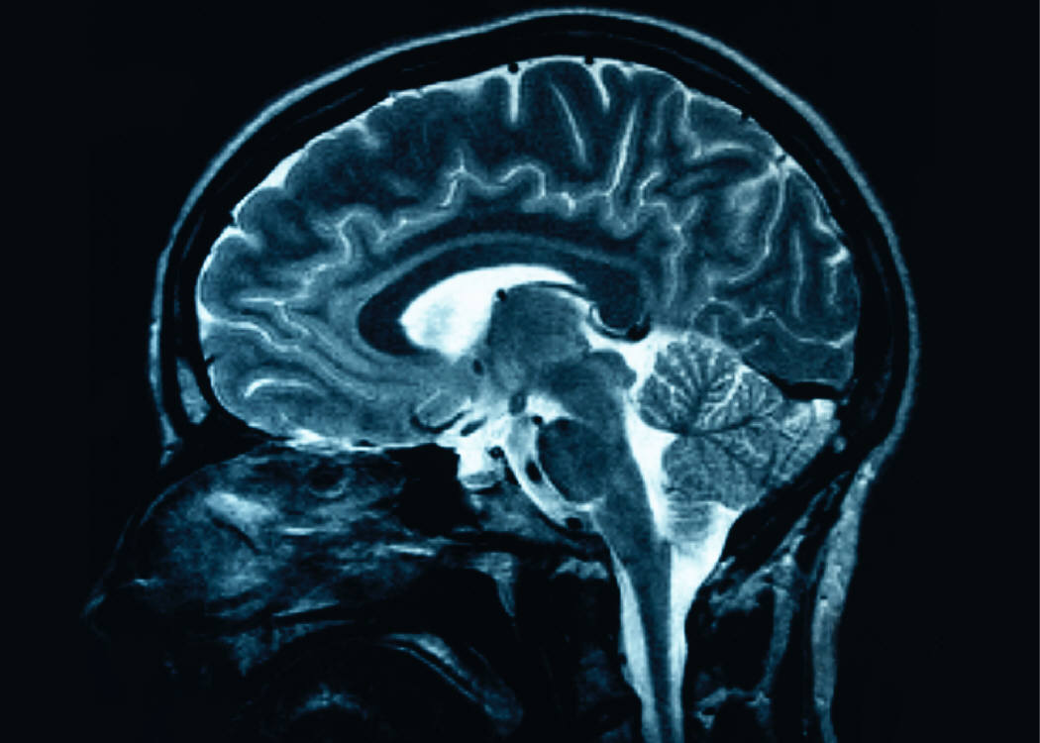
Brain Facts….
Look at posters
Put sticker on Scale
Highly Agree → Highly Disagree
Highly Disagree
Highly Agree

Slide 6
Posters should be up in room. Title at top, range ½ from Highly Agree to Highly Disagree
False
Humans only use 10% of their brain
Brain damage is always permanent
Humans have the largest brain of all animals
You are either Left-Brained (“artsy”) or Right-Brained (“logical”)
You lose large numbers of brain cells as you age
False
False
False
False

Slide 7
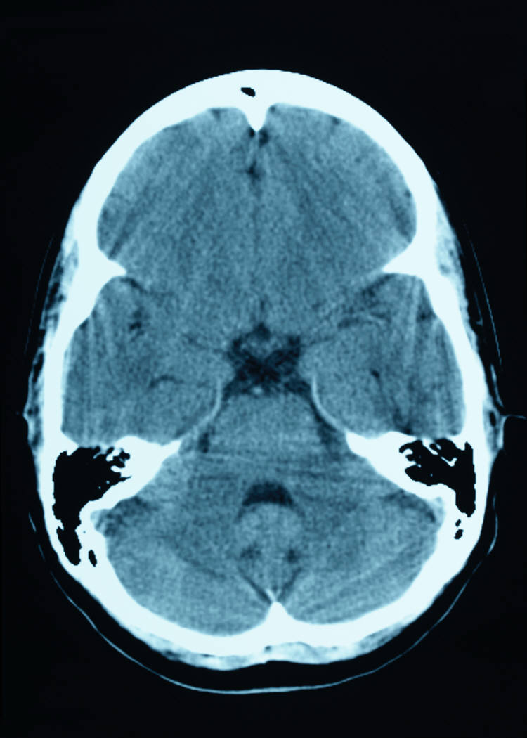
Neural engineering
Before sketch:
(Sketch out what you think it is….)
Neural engineering:
Using math and science to solve problems related to the nervous system
Central Nervous System (CNS)
Brain and Spinal Cord
Peripheral Nervous System (PNS)
Sensory Receptors
Motor Neurons
Neurons
Axon, Dendrites, Soma, Synapse, Neurotransmitters
Action Potential
What are the parts of the nervous system? (Think, what have you already learned?)

Slide 8
Neural engineering
Nervous System a System:
Fill in with your teammates
System Vocab | Nervous System Example
Disruption/Disturbance
Dynamic
Edges
Equilibrium
Feedback
Inputs
Negative Feedback
Networks
Nodes
Outputs
Positive Feedback
Subsystem
System

Slide 9
Neural engineering
Nervous System a System:
Fill in with your teammates
System Vocab | Nervous System Example
Disruption/Disturbance | damage – concussion, paralysis, numbness
Dynamic | neurons not always on → think how action potential works
Edges | neurons
Equilibrium | neurotransmitters
Feedback | neurotransmitters, neurons
Inputs | initial electrical messages, action potentials, information..(finger being burned) → stimulus
Negative Feedback | neurotransmitters (increase/decrease), homeostasis
Networks | information loop, human body
Nodes | brain, spinal cord, starting part of signal (finger being burned)
Outputs | reaction to stimulus (move finger from heat)
Positive Feedback | neurotransmitters (increase/increase)
Subsystem | Neurons have parts that must work together Brain has parts that must work together
System | Nervous system as a whole

Slide 10
Disturbance to Nervous System
Disturbance
Injury or not functioning properly
What are some examples?
(team discussion)
Class list of examples
Neural engineering helps to fix these disturbances to the nervous system

Slide 11
Disturbance to Nervous System
Disturbance
Injury or not functioning properly
What are some examples?
(team discussion)
Class list of examples
Concussion
Paralysis
Traumatic Brain Injury
Stroke
Amputation
Nerve Damage

Slide 12
Neural engineering examples
Pull 1 page from envelope
Review page
Fill in table information
Put page back into envelope
Check-in with someone that had the same page. Do you need to modify your table?
Share with teammates
  Sharer: CANNOT show table, must vocalize information
  Listeners: Make sure to repeat back what you heard so that sharer can verify the information.

Slide 13
Neural engineering examples
See Neural Engineering Examples Teacher Key for some examples of responses based on the readings.

Slide 14
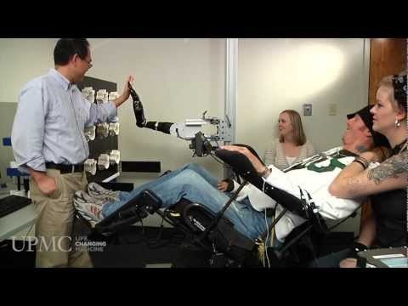
Neuroprosthetics. Try to fill in table as you watch the video.
Paralyzed Man Moves Robotic Arm with His Thoughts
University of Pittsburgh Medical Center (7:24 min)
http://www.upmc.com/media/pages/video.aspx?k=tim%20hemmes

Slide 15
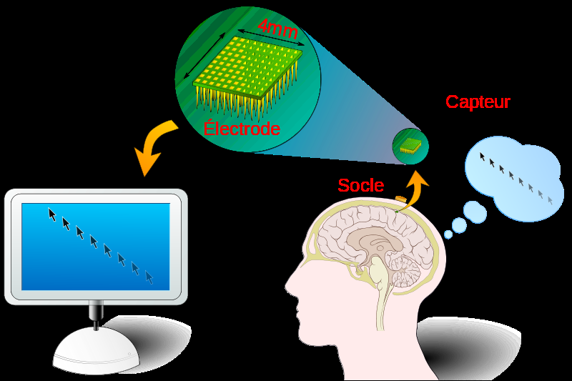
Example of Brain-Computer interface
Inputs
Outputs:
Disturbance:
Description of how device fixes disturbance:
Nodes: (main parts)
Edges: (how connected?)
Is there feedback?

Slide 16
Example of Brain Computer interface
Inputs | Signal from brain
Outputs: | Action wanted
Disturbance: | Injury to body, perhaps paralyzed and need to interact with computer
Description of how device fixes disturbance: | Signal from brain to electrode to computer that produces required reaction
Nodes: (main parts) | Brain Electrode Computer
Edges: (how connected?) | Signals, electrical
Is there Feedback?

Slide 17
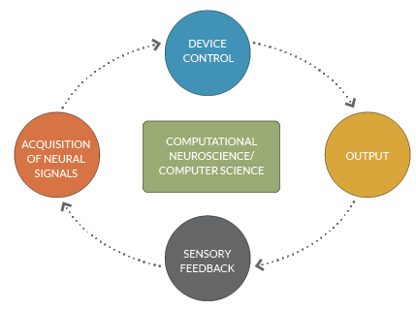
Current Research
Feedback
Sensory
Center for Sensorimotor Neural Engineering

Slide 18


Exit Ticket
Sketch out Brain-Computer Interface. Feel free to use your notes from today.
Homework
What are 5 questions you have about Neuroprosthetics and/or Brain-Computer Interfaces?
(you will have time to research them)

Slide 19
Exit Ticket
Sketch out Brain-Computer Interface. Feel free to use your notes from today.
Assess the Exit Tickets the same night. It is important that students can sketch out the brain-computer interface as it is key to their problem. If students do not add system words to their sketch, pass back the next day and ask them to add in the vocabulary. Recollect and re-grade.

